Slide 1


CAPES Meeting
REServ
Eutrophication control through bioextraction
Application of the EcoWin.NET ecosystem model
Changbo Zhu, Joao G. Ferreira, Suzanne Bricker
Universidade Nova de Lisboa, Portugal
http://ecowin.org/
Beaufort, North Carolina, July 2013

Slide 2
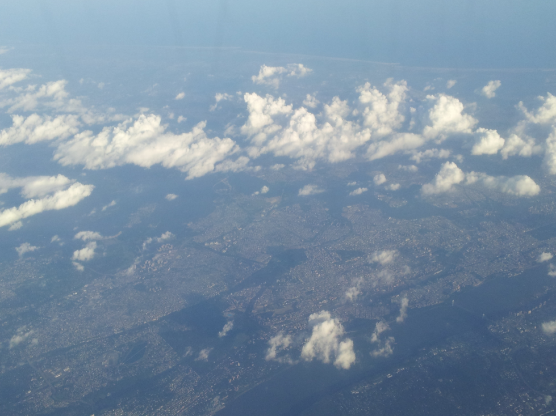
Eutrophication control through bioextraction
Application of the EcoWin.NET ecosystem model
Outline
Combination of system-scale models
EcoWin.NET setup
Tests for conservative variables
Annual cycles for nutrients and phytoplankton
Modelling of shellfish aquaculture
TEASMILE: wild species and oyster reefs
Synthesis
2
5
3
5
Slides
10
3
1
Long Island Sound, USA
2+29

Slide 3
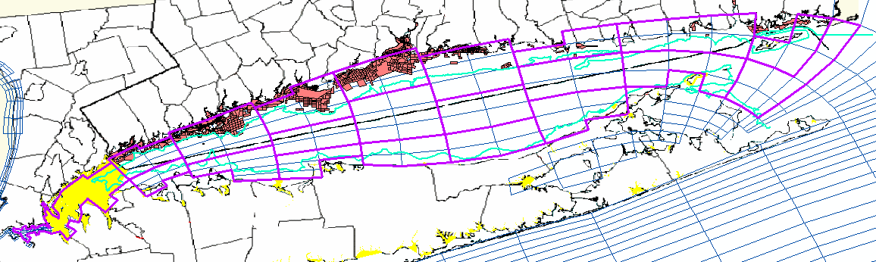
Combining models using a multicriteria approach
Criteria: (i) legal; (ii) physics; (iii) water quality; (iv) aquaculture
State borders
NY shellfish farms
CT shellfish farms
SWEM box
E2K box
50 foot depth contour
230 horizontal x 10 vertical layers in SWEM → 21 horizontal x 2 vertical boxes in E2K
Scale from 2300 to 42 cells: run culture cycles over long periods (10 years), with detailed simulation of aquaculture yield and long-term water quality

Slide 4
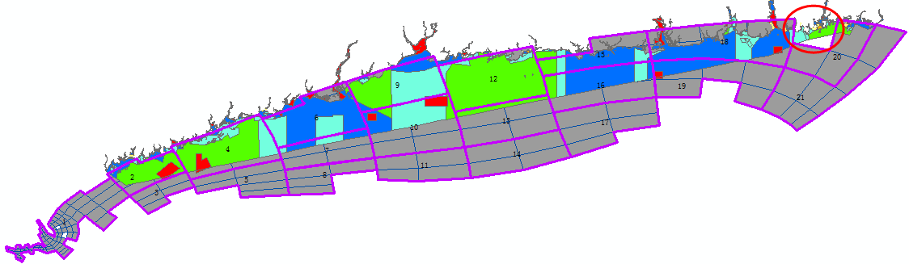
Final box layout for the EcoWin.NET ecosystem-scale carrying capacity model
SWEM grid within LIS 2300 boxes
EcoWin grid 42 boxes
The EcoWin box layout used a set of criteria based on natural and social components, agreed by partners and stakeholder associations
The SWEM model is run for one year, providing detailed water circulation for use by EcoWin. EcoWin has a specific focus on aquaculture and water quality at a decadal scale. This scale is interesting for economic models.
Water quality results for both EcoWin and SWEM can be compared, and after tuning, both models can be used to generate outputs for use in ASSETS, as an overall synthesis model, and FARM, as a local scale model

Slide 5
EcoWin.NET model – File menu and general definitions
EcoWin.NET was redesigned from the ground up in 2012-2013 for 64-bit computers.

Slide 6
EcoWin.NET model – screenshot of objects library, 1992-2013
EcoWin.NET contains a many different functional objects.

Slide 7
EcoWin.NET model – screenshot of Long Island Sound system and objects
The LIS model will contain bespoke EcoWin.NET objects.

Slide 8
EcoWin.NET model – screenshot of Long Island Sound setup file
EcoWin.NET is built for multi-year runs (10 years or more) and it runs fast.

Slide 9
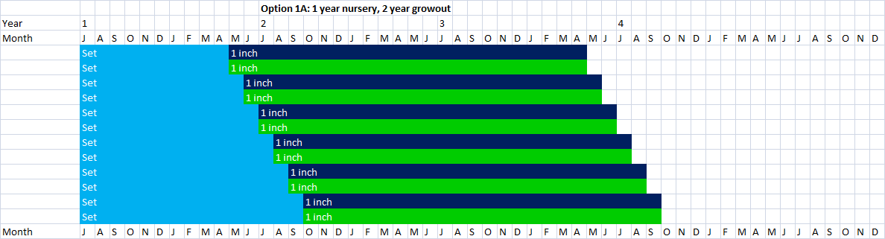
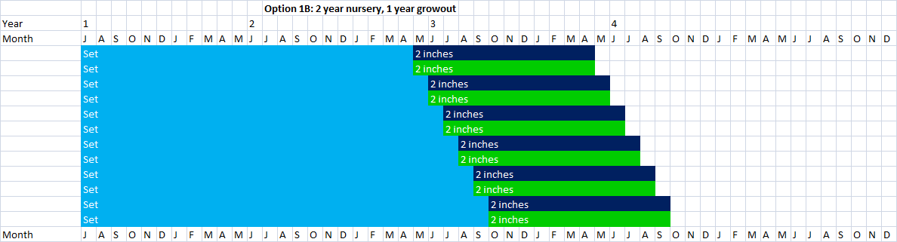
EcoWin.NET model – description of culture practice
In theory, this seems easier than writing mathematical models. In practice, an accurate description of culture practice is often a big challenge.

Slide 10
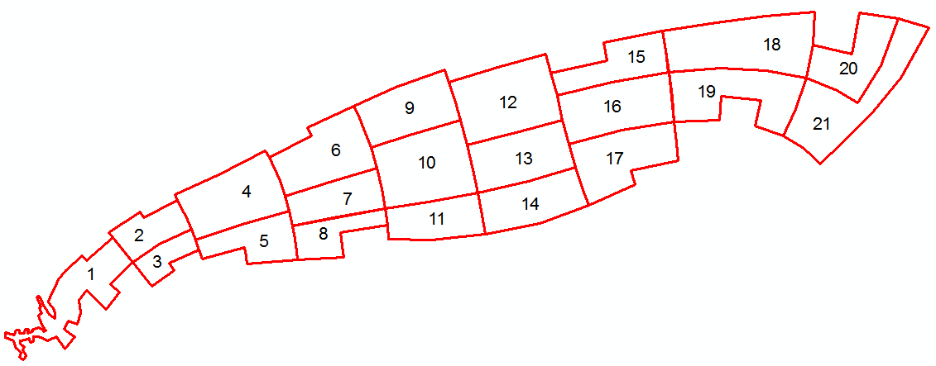
Volume variation in the 42 EcoWin boxes
Volume (m3)
Time (days)
Upper layer
Volume (m3)
Lower layer
Time (days)
Model shows conservation of volume, and a perfect match to SWEM outputs.

Slide 11
EcoWin estimates of water residence time
Tracer (no units)
Time (days)
Residence time estimates can be used to compare performance with SWEM.

Slide 12
EcoWin simulation of salinity (psu) in the model boxes
Time (days)
Second year of simulation
Time (days)
Stable salinity cycles, appropriate tidal variation, and spatial gradients.

Slide 13
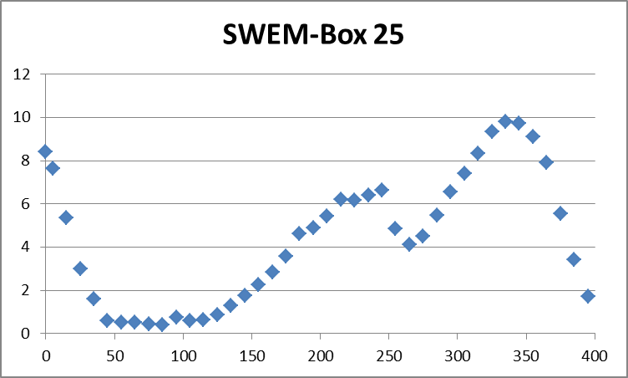
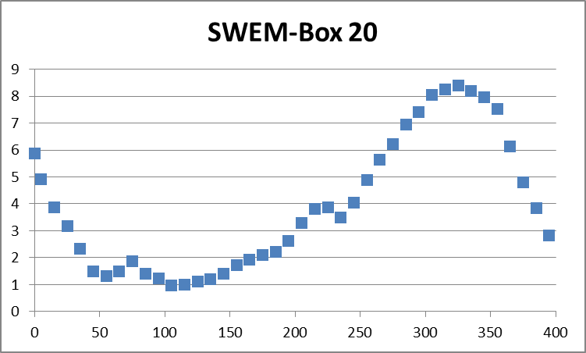
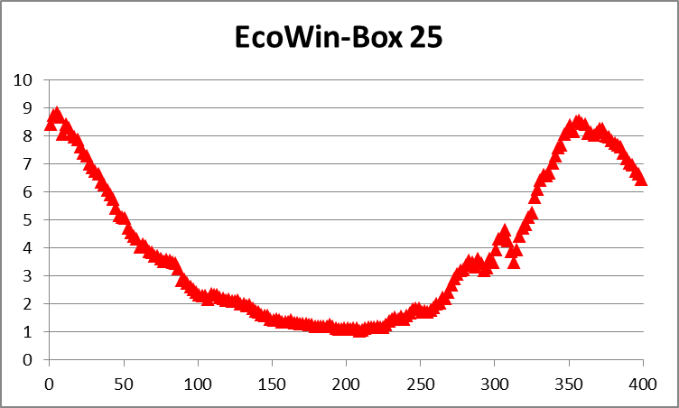
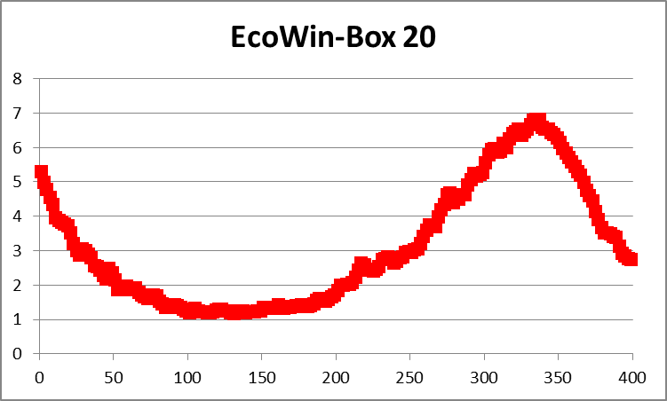
Nutrient comparisons between
SWEM and EcoWin.NET (DIN in μmol L⁻¹)
Julian day
Julian day
Nutrient simulations compare well with SWEM, both in scale and time variation.

Slide 14
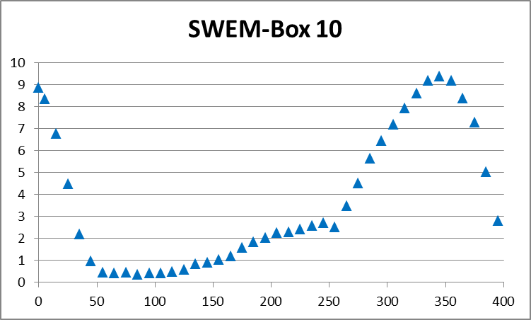
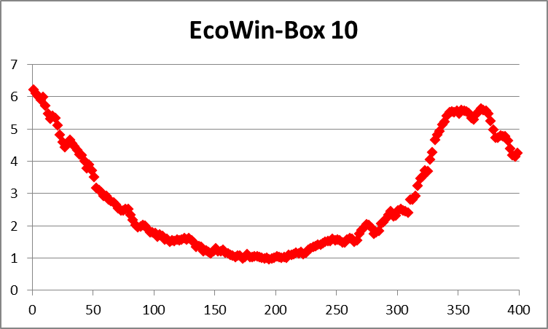
Nutrient comparisons between
SWEM and EcoWin.NET (DIN in μmol L⁻¹)
Julian day
Nutrient simulations compare well with SWEM, both in scale and time variation.

Slide 15
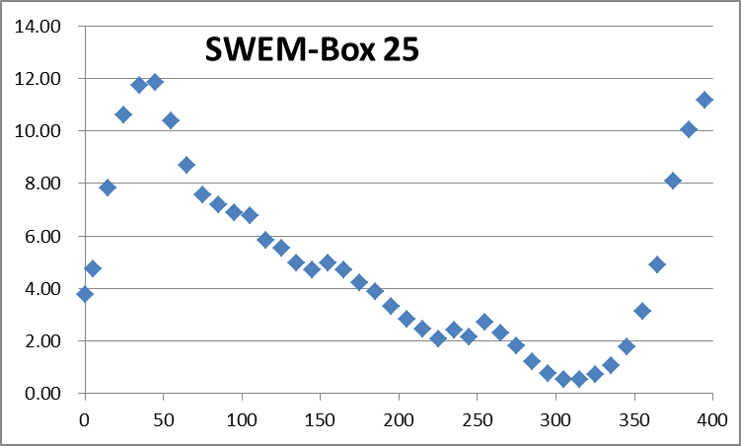
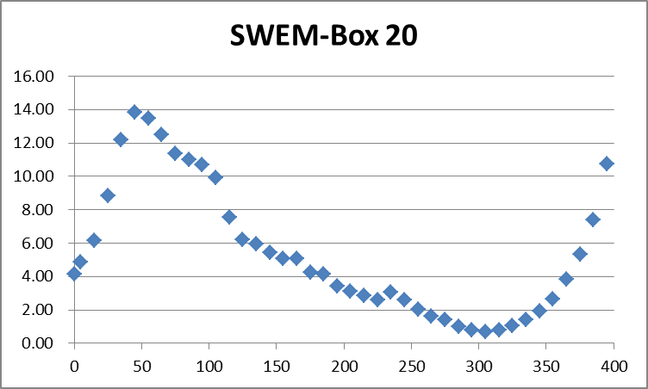
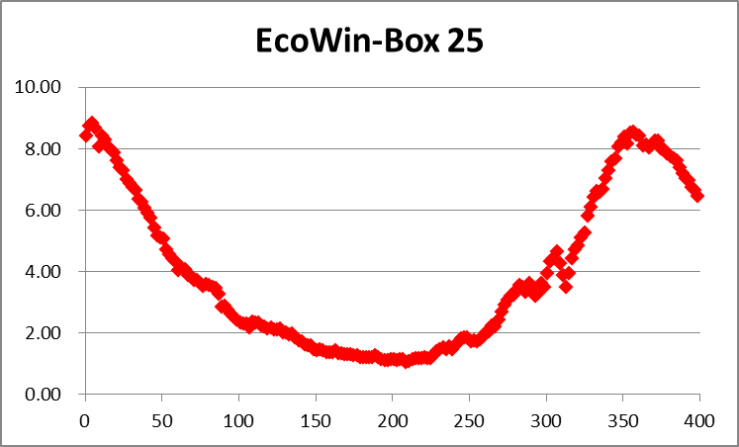
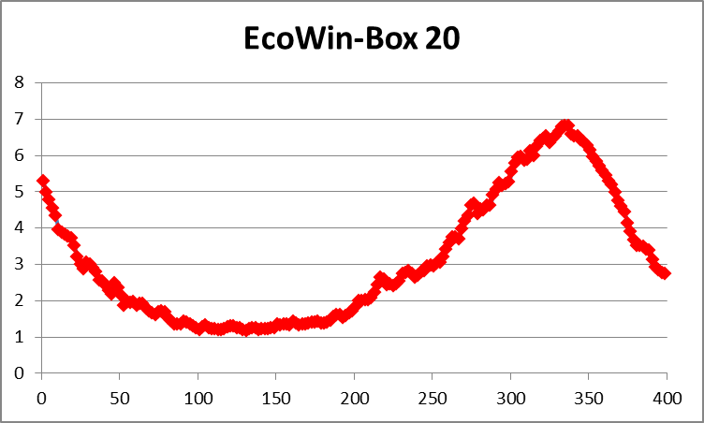
Phytoplankton comparisons between
SWEM and EcoWin.NET (chlorophyll in μg L⁻¹)
Julian day
Julian day
Chl simulations do not compare well with SWEM, both in scale and time variation.

Slide 16
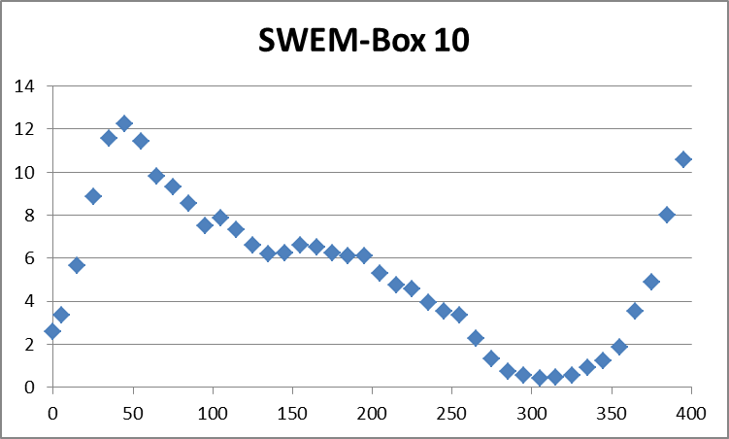

Phytoplankton comparisons between
SWEM and EcoWin.NET (chlorophyll in μg L⁻¹)
Obvious differences
Peaks in the wrong place
Much lower concentrations
Possible issues
Pmax, Iopt, mortality
Addition of zooplankton
Faster nutrient cycling
Chl simulations do not compare well with SWEM, both in scale and time variation.

Slide 17
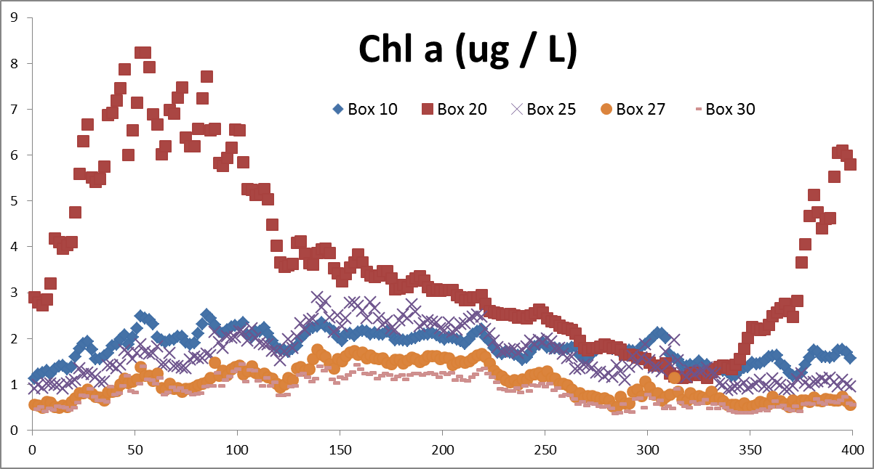
EcoWin.NET results for phytoplankton biomass with all objects switched on (output for year 5)
Julian day
There is significant variation in phytoplankton concentration among boxes, which will translate into different performance for shellfish growth.

Slide 18
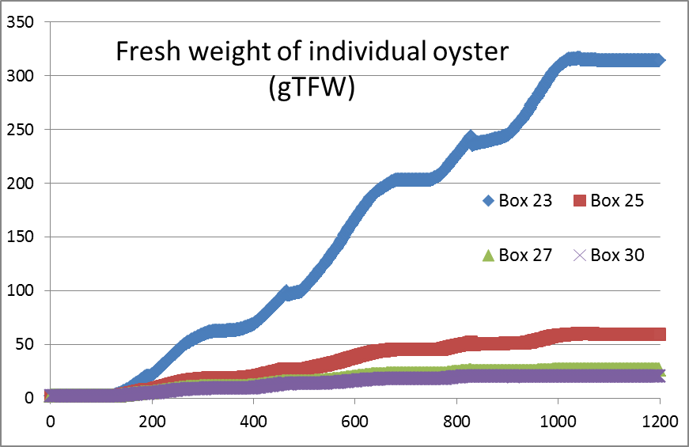
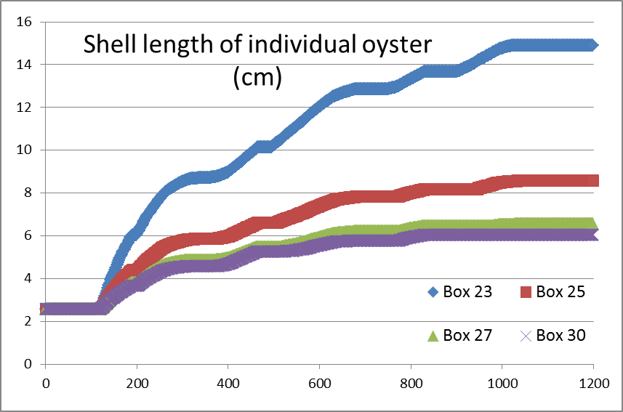
Oyster individual growth
Current version of EcoWin.NET is using C.gigas
Julian day
Replacement of the current species by the eastern oyster, already validated in AquaShell for Long Island Sound, will significantly change the growth curves above.
The timing and magnitude of phytoplankton and detrital POM peaks will also change the curves.

Slide 19
Simulation of oyster shell length with
Long Island Sound environmental drivers
The individual model provides a good fit to project data for shell length.
Notes:
For SBB: I’ve asked

Slide 20
Simulation of oyster fresh and dry weight with
Long Island Sound environmental drivers
The AquaShell model also shows a good fit to project data for live weight and for tissue dry weight. So we’re okay to move to the farm scale.

Slide 21
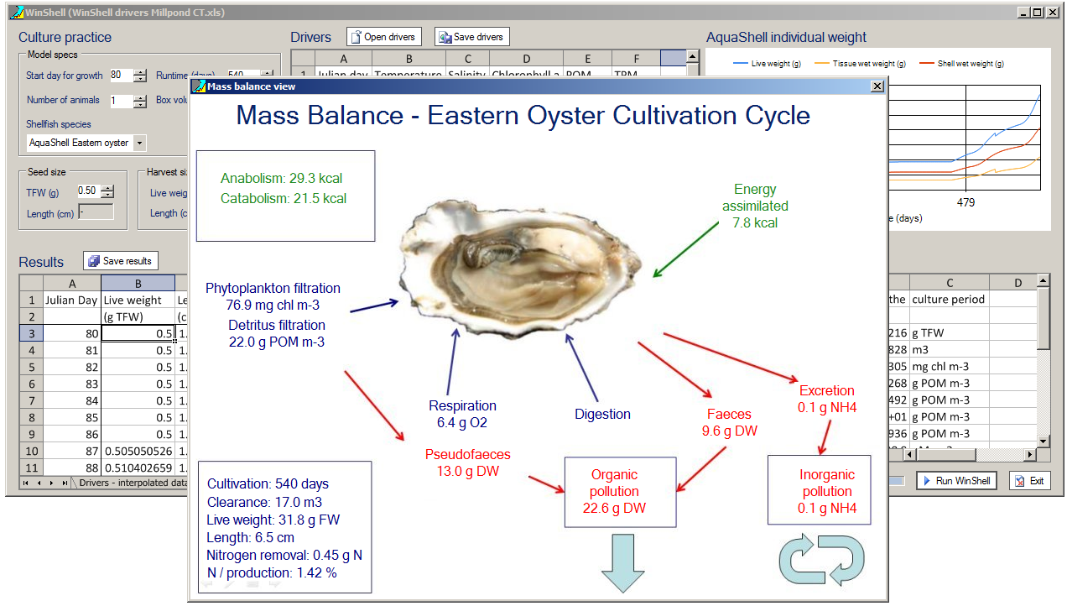
AquaShell Eastern oyster growth model
simulated mass balance
Growth simulation of oysters feeding on algae and detritus provides production
and environmental effects outputs, these then scale to population models.
http://insightmaker.com/insight/6864
Notes:
This slide shows a screen shot of the model and results for the mass balance at the end of a simulated growth cycle for an individual Eastern oyster.

Slide 22
EcoWin.NET - Oyster harvest, stable model
Day 1611, i.e.day 152 ( early June) of Year 5
 | Box 23 | Box 25 | Box 27 | Box 30 | Total
Culture area ha) | 2,787 | 8,360 | 7,246 | 1,393 | 19,786
Oyster production (ton) | 78,244 | 182,831 | 52,377 | 13,262 | 326,715
Oyster harvest (10³ bushels) | 31,297.8 | 73,132.5 | 20,950.9 | 5,304.8 | 130,686
Yield (kg m⁻² y⁻¹) | 2.8 | 2.2 | 0.7 | 1.0 | 1.7
Note: 55% oyster mortality used over the 3 year culture cycle.
This simulation uses the total lease area, divided by 3 to allow crop rotation, due to the three year growth cycle for eastern oyster in LIS. Outputs (yield) seem reasonable for a stocking density of 62 oysters m⁻².

Slide 23
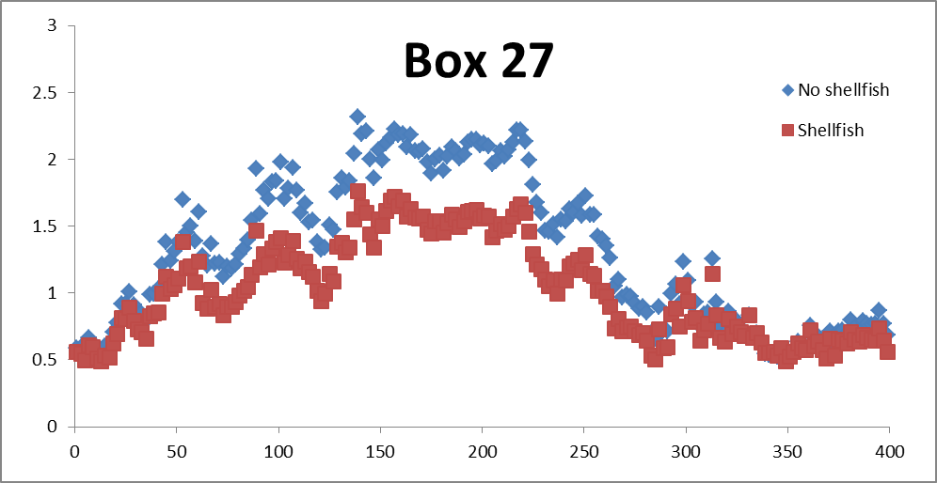
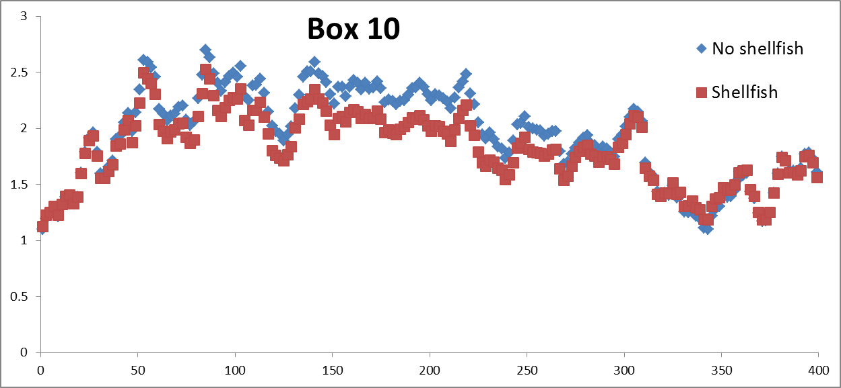
Top-down control of shellfish aquaculture on phytoplankton (chlorophyll in μg L⁻¹)
Box with shellfish beds
Box nearby without shellfish beds is also influenced
EcoWin.NET includes a mass balance feature which will allow REServ to quantify how much phytoplankton and detrital POM are removed by shellfish aquaculture.

Slide 24
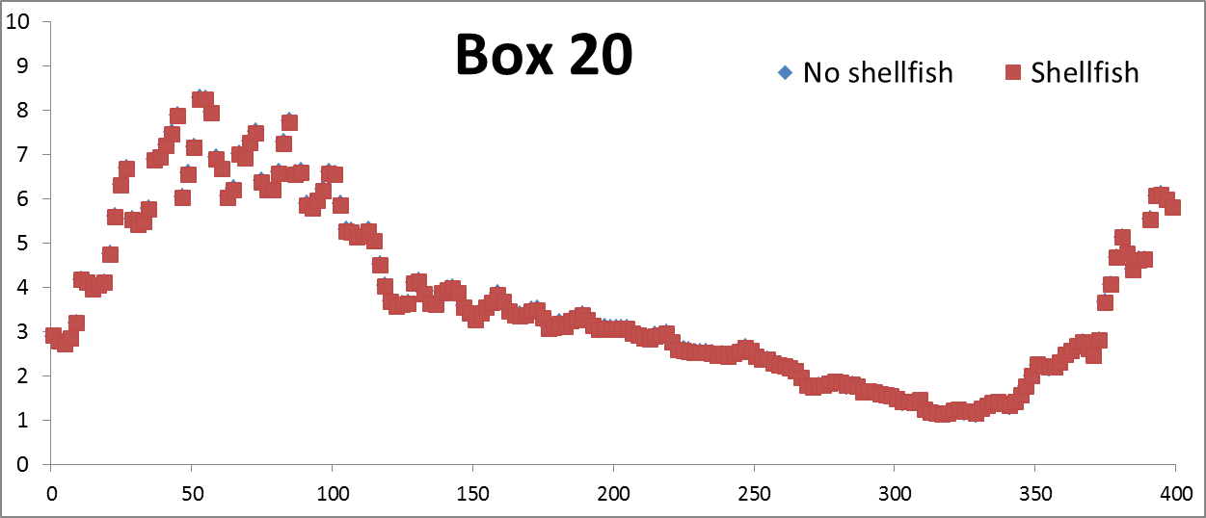
Top-down control of shellfish aquaculture on phytoplankton (chlorophyll in μg L⁻¹)
Julian day
Box in eastern Long Island Sound is apparently not influenced by shellfish aquaculture.

Slide 25
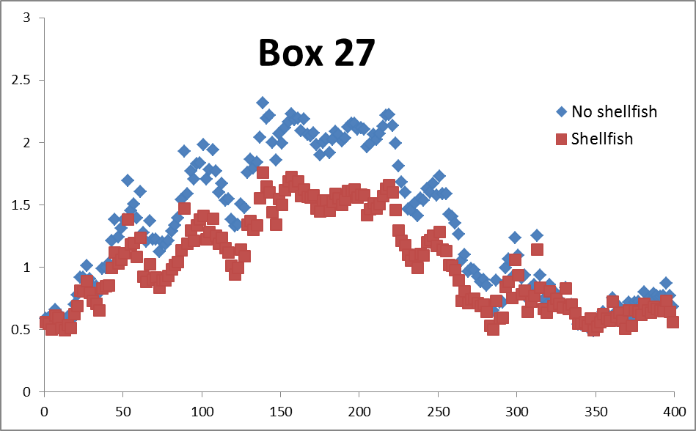
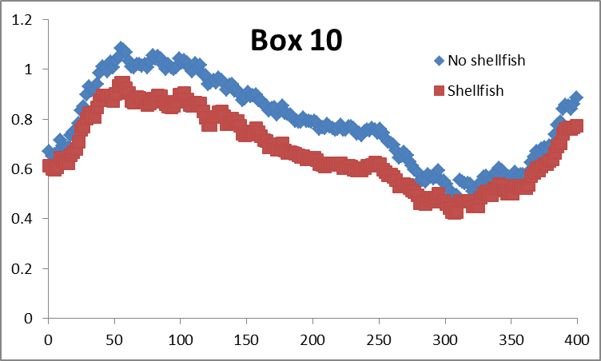
Top-down control of shellfish aquaculture on POM (mg L⁻¹)
Particulate organic matter (POM) is reduced by shellfish aquaculture in a similar way to chlorophyll.

Slide 26
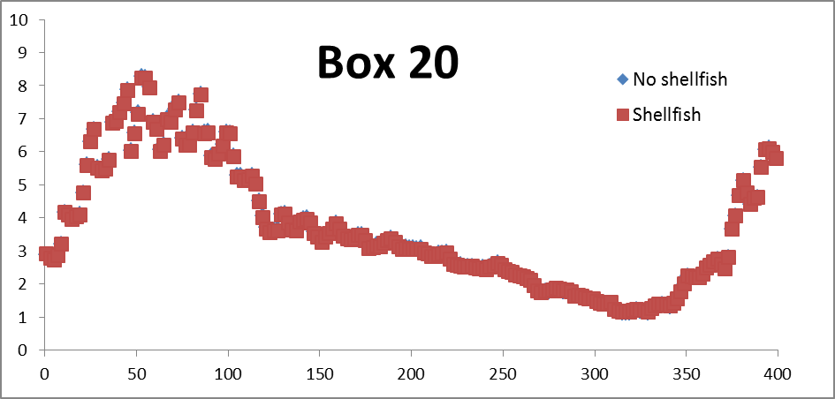
Top-down control of shellfish aquaculture on POM (mg L⁻¹).
Julian day
Box in eastern Long Island Sound is apparently not influenced by shellfish aquaculture.

Slide 27
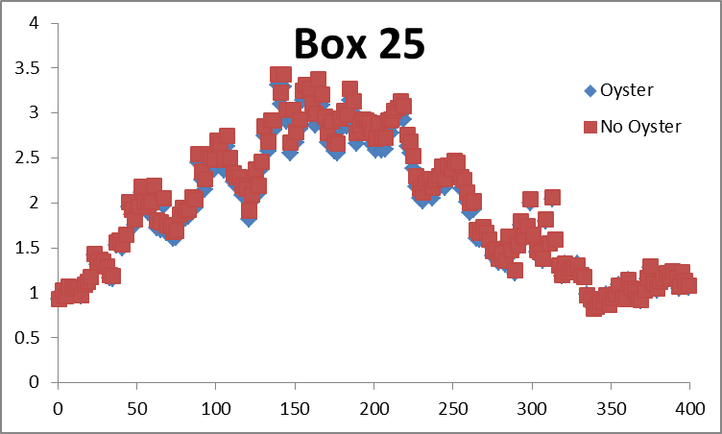
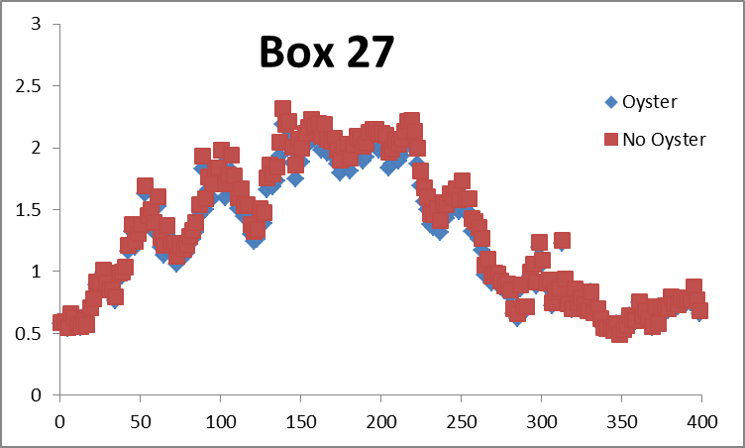
EcoWin.NET - Match of reported oyster harvest in Long Lisland Sound
Reported oyster production in 1995: 5 million bushels, about 125,000 tons.
Changes to the EcoWin model: Culture area decrease by 80%: Harvest = 133,300 tons = 5.3 million bushels.
Chl a (ug/L)
Chl a (ug/L)
Top-down control on phytoplankton concentration is no longer evident; this does not mean that there is no reduction in phytoplankton mass, but it is not visible.

Slide 28
EcoWin.NET model – TEASMILE approach for wild species
(confidential, AFBI Belfast – courtesy Heather Moore)
Collate benthic grab data by species and abundance, analyse by means of clustering software;
Select most representative species with respect to mean abundance. Around ten species will be chosen for each sediment category;
Determine typical filtration rates for selected species, using literature data;
Identify areas for the selected sediment types in each EcoWin box using GIS;
Correct for unclassified areas per EcoWin box;
Recode EcoWin to accept detailed data for wild species and simulate filtration and food removal;
Add wild species data to EcoWin;
Recalibrate and validate model;
Explore development scenarios.
This work was executed over 2012 and 2013 to address interactions among shellfish aquaculture, natural benthic communities, and eutrophication, in the context of the EU Water framework and Marine Strategy Framework Directives.

Slide 29
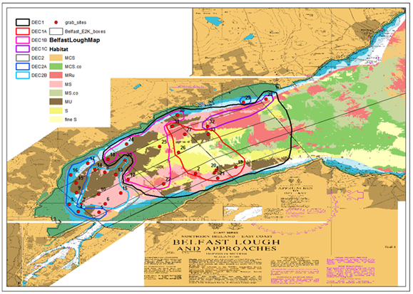
EcoWin.NET model – TEASMILE
Sample locations, Decorana groupings and sediment types
Benthic species were associated with habitat types, which were used for adding detailed filtration per box and habitat in EcoWin.

Slide 30
EcoWin.NET model – TEASMILE substrate areas
EcoWin box | 1A Sand wild species area (m²) | 1C Pebbles to boulders on sand wild sp Area (m²) |  | 2A Mud wild species area (m²) | 2B Muddy sand wild sp area (m²)
22 | 0 |  | 0 | 0 | 0
23 | 0 |  | 2957145 | 0 | 349269
24 | 4920006 |  | 22044612 | 33187 | 8300954
25 | 1010700 |  | 257289 | 936879 | 719215
26 | 263 |  | 58953 | 53953 | 893243
27 | 0 |  | 0 | 0 | 0
28 | 1201868 |  | 1017527 | 194274 | 507741
29 | 1030028 |  | 348807 | 503707 | 801918
30 | 21380 |  | 275303 | 13765 | 698801
31 | 0 |  | 0 | 0 | 2385
32 | 840160 |  | 16647161 | 0 | 7000329
33 | 904388 |  | 1752705 | 6300 | 486687
34 | 1777422 |  | 447042 | 216152 | 629728
35 | 28840 |  | 163425 | 240021 | 2585968
36 | 0 |  | 0 | 32432 | 2849
37 | 659007 |  | 1894107 | 329504 | 706387
38 | 1764675 |  | 401331 | 1209894 | 95819
39 | 26666 |  | 14333 | 2343981 | 546329
40 | 10636 |  | 518207 | 386315 | 634782
41 | 151004 |  | 158614 | 1394682 | 573975
42 | 0 |  | 481 | 600000 | 86367
These areas were associated with the most representative species, filtration rates derived from the literature, and partitioning of food added to EcoWin.

Slide 31
Synthesis
Ecosystem-scale modelling is an important step in understanding the effect of shellfish aquaculture and reef restoration on ecosystem goods and services;
This kind of broad picture makes subsequent local-scale modelling much more convincing;
System-scale scenarios can be used to plug into screening models such as ASSETS;
The EcoWin.NET REServ model will include dissolved oxygen and simulate quahogs as wild species;
TEASMILE illustrates how the wild species component can be implemented in more detail, and used for assessment of effects on water quality;
Simulation of shellfish reefs and their role on water quality is perfectly possible in EcoWin, but requires a description of recruitment (e.g. USACE), and bespoke addition of features such as the role of shellfish in denitrification.

